Slide 1
Rational Exponents and Radical Functions
Algebra 2
Chapter 5
Notes:
Algebra II 5

Slide 2
This Slideshow was developed to accompany the textbook
  Big Ideas Algebra 2
  By Larson, R., Boswell
  2022 K12 (National Geographic/Cengage)
Some examples and diagrams are taken from the textbook.
Slides created by
Richard Wright, Andrews Academy
rwright@andrews.edu

Slide 3
5-00 Properties of Exponents
After this lesson…
I can simplify expressions with exponents.
I can solve linear equations.

Slide 4


5-00 Properties of Exponents
Using Properties of Rational Exponents ac
  $x^{m}⋅x^{n}=x^{m+n}$
  ${\left(xy\right)}^{m}=x^{m}y^{m}$
  ${\left(x^{m}\right)}^{n}=x^{mn}$
  $\frac{x^{m}}{x^{n}}=x^{m−n}$
  ${\left(\frac{x}{y}\right)}^{m}=\frac{x^{m}}{y^{m}}$
  $x^{−m}=\frac{1}{x^{m}}$

Slide 5


5-00 Properties of Exponents
$x^{−4}x^{3}$
${\left({\left(x\right)}^{2}\right)}^{3}$
${\left(3^{2}x^{2}y\right)}^{2}$
Notes:
$$x^{−4+3}=x^{−1}=\frac{1}{x}$$
$${\left(x\right)}^{2·3}=x^{6}$$
$$3^{2·2}x^{2·2}y^{2}=3^{4}x^{4}y^{2}=81x^{4}y^{2}$$

Slide 6
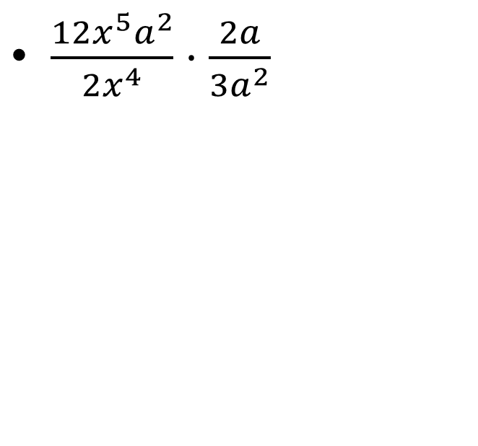

5-00 Properties of Exponents
$\frac{12x^{5}a^{2}}{2x^{4}}⋅\frac{2a}{3a^{2}}$
$\frac{5x^{2}y^{−3}}{8x^{−4}}⋅\frac{4x^{−3}y^{2}}{10x^{−2}z^{0}}$
Notes:
$$\frac{24x^{5}a^{3}}{6x^{4}a^{2}}=4xa$$
$$\frac{5·4x^{2+\left(−3\right)}y^{−3+2}}{8·10x^{−4+\left(−2\right)}z^{0}}=\frac{20x^{−1}y^{−1}}{80x^{−6}·1}=\frac{x^{−1−\left(−6\right)}y^{−1}}{4}=\frac{x^{5}}{4y}$$

Slide 7


5-00 Properties of Exponents
Solve for y
$2x+3y=9$
Solve for y
$y+2xy=10$
229 #1-3, 230 #1-13
Notes:
$$2x+3y=9→3y=−2x+9→y=−\frac{2}{3}x+3$$
$$y+2xy=10→y\left(1+2x\right)=10→y=\frac{10}{1+2x}$$

Slide 8
5.1 nth Roots and Rational Exponents
After this lesson…
• I can explain the meaning of a rational exponent.
• I can evaluate expressions with rational exponents.
• I can solve equations using nth roots.

Slide 9

5.1 nth Roots and Rational Exponents
Root
  If a² = b, then a is a square (2nd) root of b
  If a^{n} = b, then a is the n^{th} root of b
Parts of a radical
$$\sqrt[3]{64}$$
Radical Sign
Index
Radicand

Slide 10

5.1 nth Roots and Rational Exponents
Rational Exponents
  $b^{1/n}=\sqrt[n]{b}$
  $b^{m/n}=\sqrt[n]{b^{m}}={\left(\sqrt[n]{b}\right)}^{m}$
Evaluate
  ${36}^{1/2}$
Notes:
√36 = 6

Slide 11


5.1 nth Roots and Rational Exponents
${\left(\frac{1}{8}\right)}^{−\frac{1}{3}}$
${27}^{\frac{4}{3}}$
Notes:
$$8^{\frac{1}{3}}=\sqrt[3]{8}=2$$
$${\left(\sqrt[3]{27}\right)}^{4}=3^{4}=81$$

Slide 12

5.1 nth Roots and Rational Exponents
Find roots with a calculator
  The $\sqrt{x}$ or key is for square roots (either radicand then key or key then radicand depending on calculator)
  The $\sqrt[x]{y}$ or $\sqrt[y]{x}$ or $\sqrt[x]{}$is for any root (index → key → radicand OR radicand → key → index)
  Try it with $\sqrt[4]{100}$
Notes:
3.16

Slide 13
5.1 nth Roots and Rational Exponents
Steps to solve an equation with an exponent
Isolate the exponent term
Take the root of both sides where the index is the exponent
  If the index is even, put ±
Solve
Check your answers!!!

Slide 14
5.1 nth Roots and Rational Exponents
Solve. Round to two decimal places, if necessary.
5x³ = 320
(x + 3)⁴ = 24
235 #7, 9, 11, 13, 15, 17, 19, 21, 23, 27, 31, 35, 37, 39, 43, 47, 49, 51, 53, 55
Notes:
$$5x^{3}=320$$
$$x^{3}=64$$
$$x=\sqrt[3]{64}=4$$
$${\left(x+3\right)}^{4}=24$$
$$x+3=±\sqrt[4]{24}$$
$$x=−3±\sqrt[4]{24}≈−0.79 or −5.21$$

Slide 15
5-02A Properties of Rational Exponents and Simplifying Radicals
After this lesson…
• I can simplify radical expressions with rational exponents.
• I can simplify variable expressions containing rational exponents and radicals.

Slide 16


5.2 Properties of Rational Exponents and Radicals
Work with a partner.
a. The Product Property of Square Roots states that the square root of a product equals the product of the square roots of the factors.
$\sqrt{64x^{2}}=\sqrt{64}·\sqrt{x^{2}}$
Product Property of Square Roots
$=8x$ Simplify
Describe the behavior of the graphs of $y=\sqrt{64x^{2}}$ and y = 8x. What do you notice? Use technology to check your graphs and explain the results.
b. You can extend the Product Property of Square Roots to other radicals, such as cube roots.
$\sqrt[3]{64x^{3}}=\sqrt[3]{64}·\sqrt[3]{x^{3}}$
Product Property of Cube Roots
$=4x$ Simplify
Describe the behavior of the graphs of $y=\sqrt[3]{64x^{3}}$ and y = 4x. What do you notice? Use technology to check your graphs and explain the results.

Slide 17

5-02A Properties of Rational Exponents and Simplifying Radicals
Using Properties of Rational Exponents
  $x^{m}⋅x^{n}=x^{m+n}$
  ${\left(xy\right)}^{m}=x^{m}y^{m}$
  ${\left(x^{m}\right)}^{n}=x^{mn}$
  $\frac{x^{m}}{x^{n}}=x^{m−n}$
  ${\left(\frac{x}{y}\right)}^{m}=\frac{x^{m}}{y^{m}}$
  $x^{−m}=\frac{1}{x^{m}}$

Slide 18
5-02A Properties of Rational Exponents and Simplifying Radicals
6^{1/2} ⋅ 6^{1/3}
  (27^{1/3}⋅6^{1/4})²
Notes:
$$6^{\frac{1}{2}+\frac{1}{3}}→6^{\frac{3}{6}+\frac{2}{6}}→6^{\frac{5}{6}}$$
$${\left({27}^{\frac{1}{3}}\right)}^{2}⋅{\left(6^{\frac{1}{4}}\right)}^{2}→{27}^{\frac{2}{3}}⋅6^{\frac{1}{2}}→9⋅6^{\frac{1}{2}}$$

Slide 19
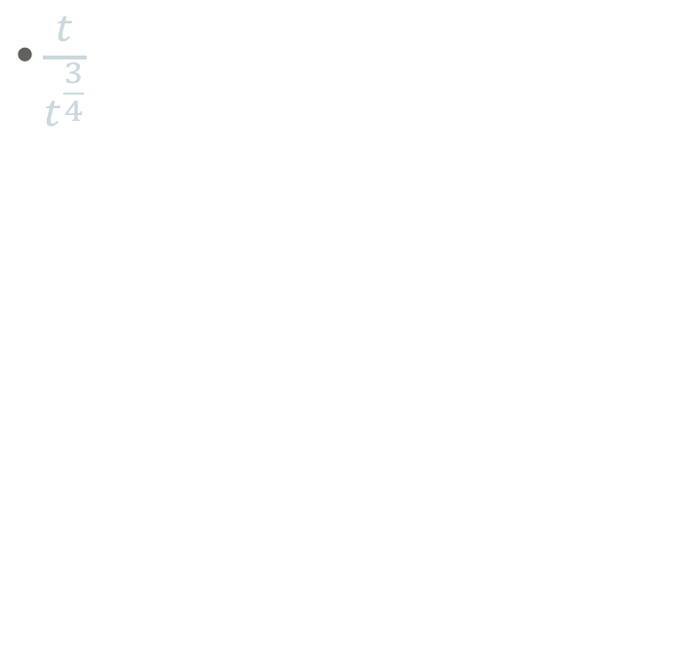
5-02A Properties of Rational Exponents and Simplifying Radicals
  (4³⋅w³)^{−1/3}
$\frac{t}{t^{\frac{3}{4}}}$
Notes:
$$4^{3−\frac{1}{3}}w^{3−\frac{1}{3}}→4^{−1}w^{−1}→\frac{1}{4} \frac{1}{w}→\frac{1}{4w}$$
$$t^{1−\frac{3}{4}} →t^{\frac{1}{4}}$$

Slide 20


5-02A Properties of Rational Exponents and Simplifying Radicals
Simplifying Radicals
  Remove any perfect roots
  Rationalize denominators
$\sqrt[4]{64}$
$\sqrt[3]{625x^{5}}$
Notes:
$$\sqrt[4]{2·2·2·2·2·2}=\sqrt[4]{\left(2·2·2·2\right)·2·2}=2\sqrt[4]{4}$$
$$\sqrt[3]{5·5·5·5·x·x·x·x·x}=\sqrt[3]{\left(5·5·5\right)·5·\left(x·x·x\right)·x·x}=5x\sqrt[3]{5x^{2}}$$

Slide 21
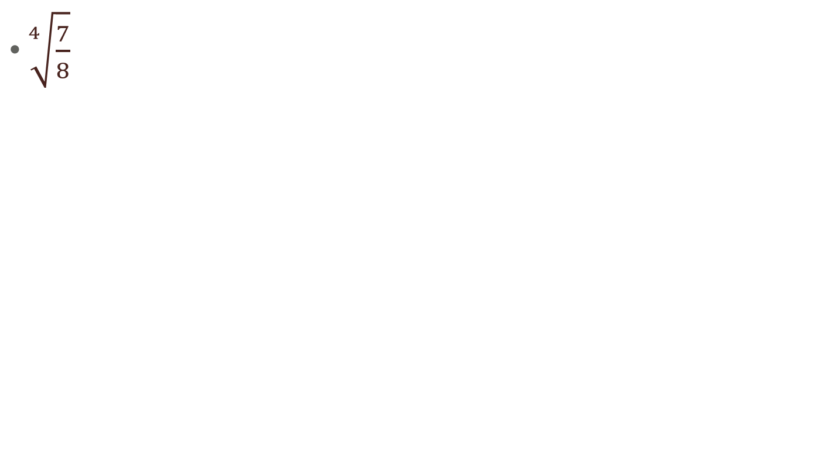

5-02A Properties of Rational Exponents and Simplifying Radicals
$\sqrt[4]{\frac{7}{8}}$
$\sqrt[5]{\frac{x^{5}}{y^{8}}}$
Notes:
$$\sqrt[4]{\frac{7}{8}}=\frac{\sqrt[4]{7}}{\sqrt[4]{8}}=\frac{\sqrt[4]{7}}{\sqrt[4]{2·2·2}}$$
$$\frac{\sqrt[4]{7}}{\sqrt[4]{2·2·2}}·\frac{\sqrt[4]{2}}{\sqrt[4]{2}}$$
$$\frac{\sqrt[4]{14}}{2}$$
$$\frac{\sqrt[5]{x^{5}}}{\sqrt[5]{y^{8}}}=\frac{\sqrt[5]{x·x·x·x·x}}{\sqrt[5]{y·y·y·y·y}\sqrt[5]{y·y·y}}=\frac{x}{y\sqrt[5]{y^{3}}}·\frac{\sqrt[5]{y^{2}}}{\sqrt[5]{y^{2}}}=\frac{x·\sqrt[5]{y^{2}}}{y^{2}}$$

Slide 22


5-02A Properties of Rational Exponents and Simplifying Radicals
$\frac{1}{\sqrt{7}−2}$
$\frac{2}{3+\sqrt{5}}$
Notes:
$$\frac{1}{\sqrt{7}−2}·\frac{\sqrt{7}+2}{\sqrt{7}+2}$$
$$\frac{\sqrt{7}+2}{7+2\sqrt{7}−2\sqrt{7}−4}$$
$$\frac{\sqrt{7}+2}{3}$$
$$\frac{2}{3+\sqrt{5}}·\frac{3−\sqrt{5}}{3−\sqrt{5}}$$
$$=\frac{6−2\sqrt{5}}{9−3\sqrt{5}+3\sqrt{5}−5}$$
$$=\frac{6−2\sqrt{5}}{4}$$
$$=\frac{3−\sqrt{5}}{2}$$

Slide 23
5-02B Operations with Radicals
After this lesson…
• I can simplify radical expressions with rational exponents.
• I can simplify variable expressions containing rational exponents and radicals.

Slide 24

5-02B Operations with Radicals
Using Properties of Radicals
  Product Property →
    $\sqrt[n]{a∙b}=\sqrt[n]{a}∙\sqrt[n]{b}$
  Quotient Property →
    $\sqrt[n]{\frac{a}{b}}=\frac{\sqrt[n]{a}}{\sqrt[n]{b}}$

Slide 25
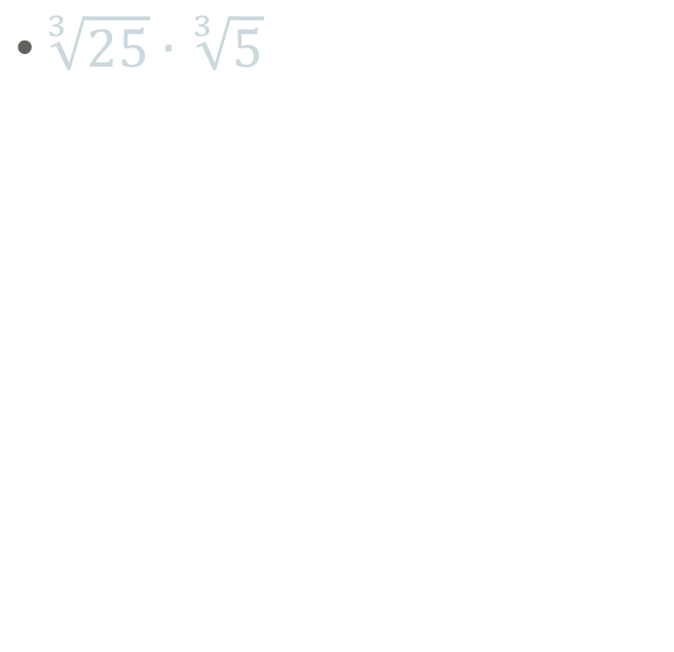
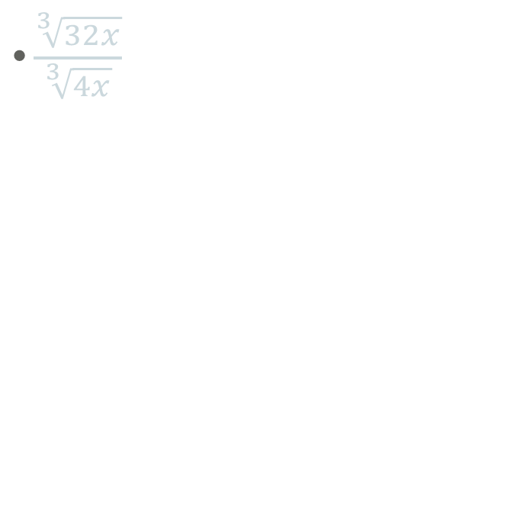
5-02B Operations with Radicals
$\sqrt[3]{25}∙\sqrt[3]{5}$
$\frac{\sqrt[3]{32x}}{\sqrt[3]{4x}}$
Notes:
$$\sqrt[3]{25·5}=\sqrt[3]{125}=5$$
$$\sqrt[3]{\frac{32x}{4x}}=\sqrt[3]{8}=2$$

Slide 26
5-02B Operations with Radicals
Adding and Subtracting Roots and Radicals
  Simplify the radicals
  Combine like terms
5(4^{3/4}) − 3(4^{3/4})
Notes:
2(4^{3/4})

Slide 27


5-02B Operations with Radicals
$\sqrt[3]{81}−\sqrt[3]{3}$
$2\sqrt[4]{6x^{5}}+x\sqrt[4]{6x}$
Notes:
$$\sqrt[3]{3·3·3·3}−\sqrt[3]{3}=3\sqrt[3]{3}−\sqrt[3]{3}=2\sqrt[3]{3}$$
$$2x\sqrt[4]{6x}+x\sqrt[4]{6x}=3x\sqrt[4]{6x}$$

Slide 28
5.3 Graphing Radical Equations
After this lesson…
• I can graph radical functions.
• I can describe transformations of radical functions.
• I can write functions that represent transformations of radical functions.

Slide 29

5.3 Graphing Radical Equations
Work with a partner.
Graph each function. How are the graphs alike? How are they different?
i. $f\left(x\right)=\sqrt{x}$
ii. $f\left(x\right)=\sqrt[3]{x}$
iii. $f\left(x\right)=\sqrt[4]{x}$
iv. $f\left(x\right)=\sqrt[5]{x}$

Slide 30


5.3 Graphing Radical Equations
$$y=\sqrt{x}$$
$$y=\sqrt[3]{x}$$
domain x≥0
range y≥0
Domain: all real numbers
Range: all real numbers
Notes:
√x → domain x≥0; range y≥0
³√x → domain x all real numbers; range y all real numbers

Slide 31
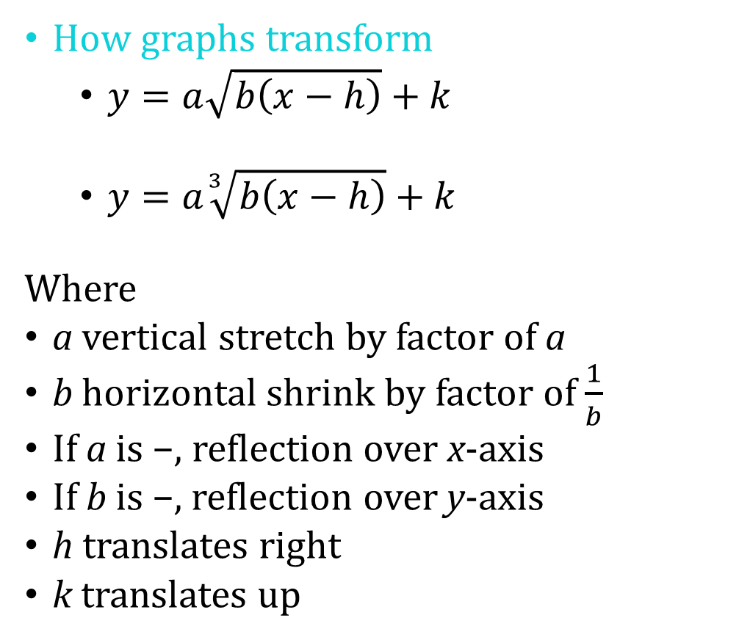
5.3 Graphing Radical Equations
How graphs transform
  $y=a\sqrt{b\left(x−h\right)}+k$
  $y=a\sqrt[3]{b\left(x−h\right)}+k$
Where
a vertical stretch by factor of a
b horizontal shrink by factor of $\frac{1}{b}$
If a is −, reflection over x-axis
If b is −, reflection over y-axis
h translates right
k translates up
Graph by making a table of values.

Slide 32


5.3 Graphing Radical Equations
Describe the transformation of f represented by g. Then graph each function.
$f\left(x\right)=\sqrt{x}$; $g\left(x\right)=\sqrt{x+2}−3$
$f\left(x\right)=\sqrt[3]{x}$; $g\left(x\right)=−\sqrt[3]{2x}$

Slide 33

5.3 Graphing Radical Equations
The function $E\left(d\right)=0.25\sqrt{d}$ approximates the number of seconds it takes a dropped object to fall d feet on Earth. The function J(d) = 0.63 ⋅ E(d) approximates the number of seconds it takes a dropped object to fall d feet on Jupiter. How long does it take a dropped object to fall 81 feet on Jupiter?
Notes:
$$E\left(81\right)=0.25\sqrt{81}=2.25$$
$$J\left(81\right)=0.63·E\left(81\right)=0.63·2.25=1.42 s$$

Slide 34

5.3 Graphing Radical Equations
Let the graph of g be a horizontal stretch by a factor of 3, followed by a translation 6 units right of the graph of $f\left(x\right)=\sqrt[3]{x}$. Write a rule for g.
Notes:
First $b=\frac{1}{3}$
$$g\left(x\right)=\sqrt[3]{\frac{1}{3}x}$$
Second $h=6$
$$g\left(x\right)=\sqrt[3]{\frac{1}{3}\left(x−6\right)}$$
$$g\left(x\right)=\sqrt[3]{\frac{1}{3}x−2}$$

Slide 35

5.3 Graphing Radical Equations
Graphing horizontal parabolas and circles
  Solve the equation for y.
  Create a table of values.
  Plot the points and draw graph.
Graph $−\frac{1}{5}y^{2}=x$. Identify the vertex and the direction that the parabola opens.
Notes:
$$−\frac{1}{5}y^{2}=x$$
$$y^{2}=−5x$$
$$y=±\sqrt{−5x}$$
Opens left, vertex (0, 0)

Slide 36

5.3 Graphing Radical Equations
Graph $x^{2}+y^{2}=49$. Identify the radius and the intercepts.
250 #1, 5, 9, 13, 17, 21, 25, 29, 33, 37, 39, 41, 45, 49, 59, 67, 69, 71, 73, 79
Notes:
$$x^{2}+y^{2}=49$$
$$y^{2}=49−x^{2}$$
$$y=±\sqrt{49−x^{2}}$$
Radius = 7
x-ints: (±7, 0)
y-ints: (0, ±7)

Slide 37
5.4 Solving Radical Equations and Inequalities
After this lesson…
• I can identify radical equations and inequalities.
• I can solve radical equations and inequalities.
• I can identify extraneous solutions of radical equations.
• I can solve real-life problems involving radical equations.

Slide 38

5.4 Solving Radical Equations and Inequalities
Work with a partner.
a. Two students solve the equation $x+2=\sqrt{5x+16}$ as shown. Justify each solution step in the fi rst student’s solution. Then describe each student’s method. Are the methods valid? Explain.
Notes:
a. Square each side of the equation; Simplify; Combine like terms; Factor; Set each factor equal to 0; Simplify; Student 1 squared each side of the equation and solved algebraically. Student 2 graphed each side of the equation and found the point of intersection; yes; Both methods are mathematically correct.

Slide 39
5.4 Solving Radical Equations and Inequalities
Radical Equation
  Equation containing a radical
Steps
Isolate the radical
Raise both sides to whatever the index is (or the reciprocal of the exponent)
Solve
Check your answers!!!

Slide 40
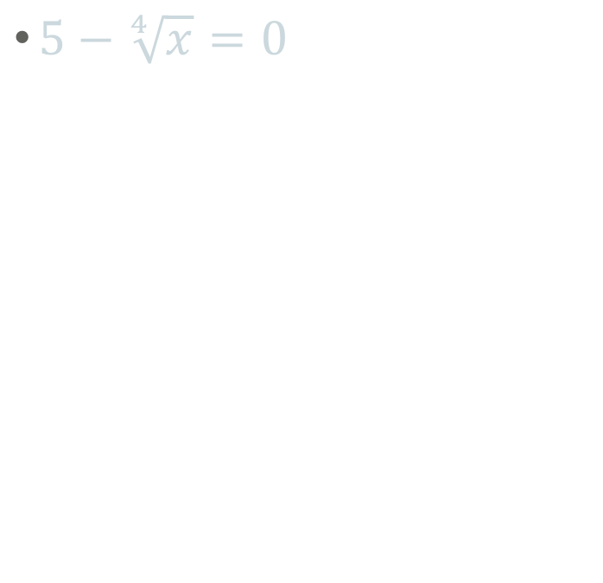
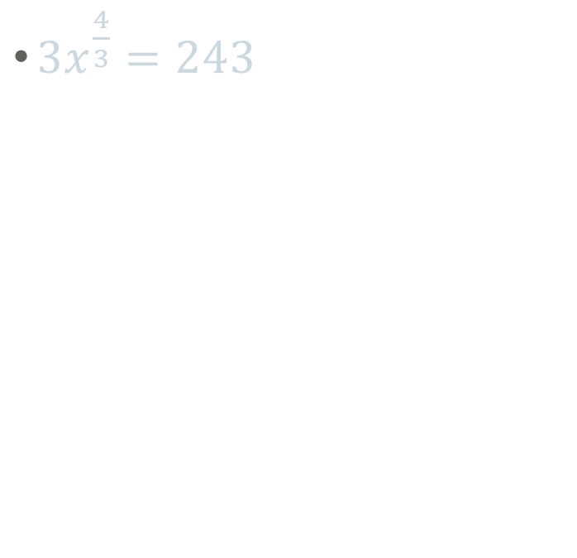
5.4 Solving Radical Equations and Inequalities
$5−\sqrt[4]{x}=0$
$3x^{\frac{4}{3}}=243$
Notes:
$$5=\sqrt[4]{x} → 5^{4}=x → x=625$$
$$x^{\frac{4}{3}}=81 → x=±{81}^{\frac{3}{4}}=±27$$

Slide 41
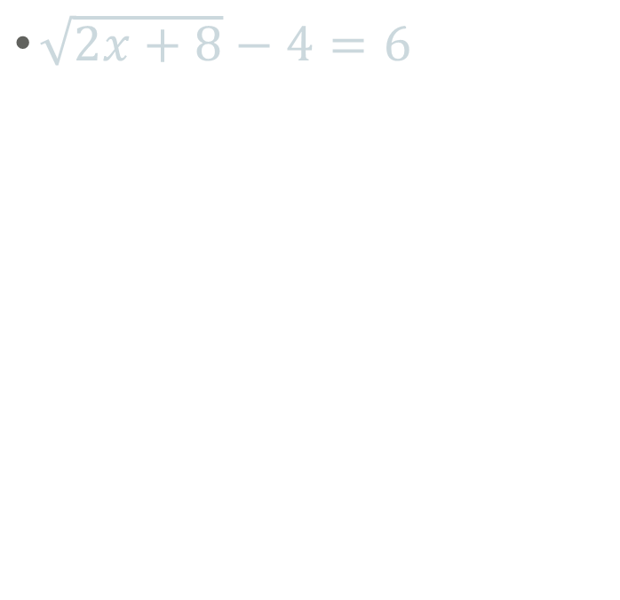
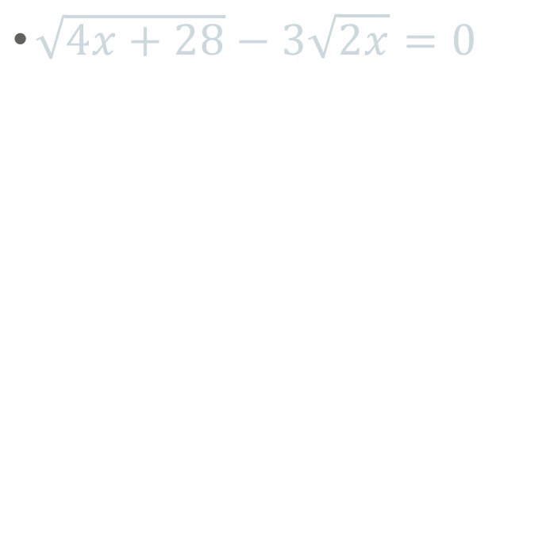
5.4 Solving Radical Equations and Inequalities
$\sqrt{2x+8}−4=6$
$\sqrt{4x+28}−3\sqrt{2x}=0$
Notes:
$$\sqrt{2x+8}=10 → 2x+8=100 → 2x=92 → x=46$$
$$\sqrt{4x+28}=3\sqrt{2x} → 4x+28=9(2x) → 4x+28=18x → 28=14x → x=2$$

Slide 42

5.4 Solving Radical Equations and Inequalities
$x+2=\sqrt{2x+28}$
Check!
258 #1, 5, 9, 13, 17, 21, 25, 29, 31, 33, 37, 41, 45, 49, 51, 57, 61, 69, 77, 81
Notes:
$${\left(x+2\right)}^{2}=2x+28 → x^{2}+4x+4=2x+28 → x^{2}+2x−24=0 → (x+6)(x−4)=0 → x=−6, 4$$
Check
-6: $−6+2=\sqrt{2\left(−6\right)+28} → −4=\sqrt{−12+28} → −4=4$ False
4: $4+2=\sqrt{2\left(4\right)+28} → 6=\sqrt{36} → 6=6$ True

Slide 43
5.5 Performing Function Operations
After this lesson…
• I can explain what it means to perform an arithmetic operation on two functions.
• I can fi nd arithmetic combinations of two functions.
• I can state the domain of an arithmetic combination of two functions.
• I can evaluate an arithmetic combination of two functions for a given input.

Slide 44
5.5 Performing Function Operations
Work with a partner. Consider the graphs of f and g.
a. Describe what it means to add two functions. Then describe what it means to subtract one function from another function.

Slide 45
5.5 Performing Function Operations
Sometimes for your problems you need to repeat several calculations over and over again (think science class).
It would be quicker to combine all the equations that you are using into one equation first, so that you only have to do one equation each time instead of many.

Slide 46

5.5 Performing Function Operations
Ways to combine functions
Addition: $(f+g)(x)=f(x)+g(x)$
Subtraction: $\left(f−g\right)\left(x\right)=f\left(x\right)−g(x)$
Multiplication: $\left(f·g\right)\left(x\right)=f\left(x\right)·g(x)$
Division: $\left(\frac{f}{g}\right)(x)=\frac{f\left(x\right)}{g\left(x\right)}$

Slide 47

5.5 Performing Function Operations
Given $f(x)=5\sqrt{x}$ and $g\left(x\right)=−8\sqrt{x}$ find
  $(f+g)(x)$
  $(f−g)(x)$
  $(f·g)(x)$
  $\left(\frac{f}{g}\right)(x)$
Notes:
$$−3\sqrt{x} D: x≥0$$
$$13\sqrt{x} D: x≥0$$
$$−40x D: x≥0$$
$$−\frac{5}{8} D: x > 0$$

Slide 48

5.5 Performing Function Operations
Let $f\left(x\right)=2x^{3}+4x^{2}−8x+4$ and $g\left(x\right)=3x^{3}−5x^{2}+6x−9$. Find
$(f−g)( x)$ and state the domain. Then evaluate $(f−g)(−1)$.
Notes:
$\left(f−g\right)\left(x\right)=−x^{3}+9x^{2}−14x+13$ and the domain is all real numbers; (f − g)(−1) = 37

Slide 49

5.5 Performing Function Operations
Let $f(x)=x^{3}$ and $g\left(x\right)=\sqrt{x}$. Find $\left(fg\right)\left(x\right)$ and state the domain. Then evaluate $(fg)(4)$.
Notes:
$$\left(fg\right)\left(x\right)=\left(x^{3}\right)\left(\sqrt{x}\right)=x^{3}x^{\frac{1}{2}}=x^{3+\frac{1}{2}}=x^{\frac{7}{2}}$$
$\left(fg\right)\left(x\right)=x^{\frac{7}{2}}$ and the domain is all nonnegative real numbers; (fg)(4) = 128

Slide 50

5.5 Performing Function Operations
From 2010 to 2020, the populations (in thousands) of City M and City N can be modeled by $M\left(t\right)=3.3t^{3}+12.1t^{2}−0.65t+15.8$ and
$N\left(t\right)=2.5t^{3}+7.8t^{2}+0.41t+11.9$, where t is the number of years since 2010. Find (M − N)(t) and explain what it represents.
265 #1, 3, 5, 7, 9, 15, 17, 21, 23, 25, 27, 29, 35, 37, 39
Notes:
$\left(M−N\right)\left(t\right)=0.8t^{3}+4.3t^{2}−1.06t+3.9$;
Subtracting the populations gives how much greater the population of City M is than the population City N for t years after 2010.

Slide 51
5.6 Composition of Functions
After this lesson…
• I can evaluate a composition of functions.
• I can fi nd a composition of functions.
• I can state the domain of a composition of functions.

Slide 52

5.6 Composition of Functions
Work with a partner.
The formulas below represent the temperature F (in degrees Fahrenheit) when the temperature is C degrees Celsius, and the temperature C when the temperature is K (Kelvin).
$$F=\frac{9}{5}C+32 C=K−273$$
a. Write an expression for F in terms of K.
Notes:
$$F=\frac{9}{5}K−\frac{2297}{5}$$

Slide 53
5.6 Composition of Functions
Composition
  Put one function into the other. (Like substitution)
  Written g(f(x))
  Said “g of f of x”
  Means that the output (range) of f is the input (domain) of g. Work from the inside out. Do f(x) first then g(x).
  f(x) gets substituted into g(x)

Slide 54

5.6 Composition of Functions
Let $f\left(x\right)=\sqrt{3x−5}$ and
$g\left(x\right)=x^{2}+1$.
Find the indicated value.
a. g(f (2))
b. f(g(3))
c. g(g(−3))
Notes:
$f\left(2\right)=\sqrt{3\left(2\right)−5}=1→g\left(f\left(2\right)\right)=g\left(1\right)=1^{2}+1=2$
$g\left(3\right)=3^{3}+1=10 →f\left(g\left(3\right)\right)=f\left(10\right)=\sqrt{3\left(10\right)−5}=5$
$g\left(−3\right)={\left(−3\right)}^{2}+1=10→g\left(g\left(−3\right)\right)=g\left(10\right)={\left(10\right)}^{2}+1=101$

Slide 55

5.6 Composition of Functions
Let $f\left(x\right)=3x^{−1}$ and $g(x)=4x−5$.
Perform the indicated operation and state the domain.
a. f(g(x))
b. g(f(x))
c. f(f(x))
Notes:
g substituted into f. $f\left(g\left(x\right)\right)=3{\left(4x−5\right)}^{−1}=\frac{3}{4x−5}$
Domain of g is all real numbers. Domain of $f\left(g\left(x\right)\right)$ is $4x−5≠0→x≠\frac{5}{4}$
f substituted into g. $g\left(f\left(x\right)\right)=4\left(3x^{−1}\right)−5=12x^{−1}−5=\frac{12}{x}−5$
Domain of f is x≠0. Domain of $g\left(f\left(x\right)\right)$ is also x≠0.
f substituted into f. $f\left(f\left(x\right)\right)=3{\left(3x^{−1}\right)}^{−1}=3\left(3^{−1}x^{1}\right)=\frac{3x}{3}=x$
Domain of f is x≠0. Domain of $f\left(f\left(x\right)\right)$ is all real numbers except the domain of the original input f limits the domain of the composition so the domain of f(f(x)) is x≠0.

Slide 56
5.6 Composition of Functions
The function C(x) = 8.74x represents the cost (in dollars) of producing x shirts. The number of shirts produced in t hours is represented by x(t) = 84t. (a) Find C(x(t)). (b) Evaluate C(x(40)) and explain what it represents.
271 #1, 5, 9, 13, 17, 21, 25, 31, 33, 37, 43, 45, 47, 49, 51
Notes:
x is substituted into C. $C\left(x\left(t\right)\right)=8.74\left(84t\right)=734.16t$
$C\left(x\left(40\right)\right)=734.16\left(40\right)=29366.4$ This is the cost of producing shirts for 40 hours and the cost is $29,366.40

Slide 57
5.7 Inverse of a Function
After this lesson…
• I can explain what inverse functions are.
• I can fi nd inverses of linear and nonlinear functions.
• I can determine whether a pair of functions are inverses.

Slide 58

5.7 Inverse of a Function
Work with a partner.
a. Consider each pair of functions, f and g, below. For each pair, create an input-output table of values for each function. Use the outputs of f as the inputs of g. What do you notice about the relationship between the equations of f and g?
i. $f\left(x\right)=4x+3;g\left(x\right)=\frac{x−3}{4}$

Slide 59
5.7 Inverse of a Function
Sometimes you want to do the opposite operation that a given function or equation gives you.
To do the opposite, or undo, the operation you need the inverse function.

Slide 60
5.7 Inverse of a Function
Properties of Inverses
  x and y values are switched
  graph is reflected over the line y = x
You can use the Horizontal Line test to determine if the inverse of a function is also a function.
  If a horizontal line can touch a graph more than once, then the inverse is not a function.

Slide 61

5.7 Inverse of a Function
Definition of inverses
  Two functions are inverses if and only if
    $f\left(g\left(x\right)\right)=x$and $g\left(f\left(x\right)\right)=x$

Slide 62

5.7 Inverse of a Function
Verify that $f\left(x\right)=6−2x$ and $g\left(x\right)=\frac{6−x}{2}$ are inverses.
Notes:
[f ° g](x) = 6 – 2((6 - x)/2) = 6 – 2(3 – x/2) = 6 – 6 + x = x
[g ° f](x) = (6 – (6 – 2x))/2 = (6 – 6 + 2x)/2 = 2x/2 = x
yes they are inverses

Slide 63

5.7 Inverse of a Function
Finding inverses
  Inverses switch the x and y coordinates
  Switch x and y and solve for y.
$y=2x+7$
Notes:
$$y=2x+7$$
$$x=2y+7$$
$$x−7=2y$$
$$\frac{x−7}{2}=y$$

Slide 64

5.7 Inverse of a Function
Find the inverse
$f\left(x\right)=x^{4}+2, x≤0$
Notes:
Rewrite f(x) as y $y=x^{4}+2, x≤0$
Switch the x and y $x=y^{4}+2, y≤0$
Solve for y $x−2=y^{4}, y≤0$
$y=±\sqrt[4]{x−2}, y≤0$
Rewrite y as $f^{\left(−1\right)}\left(x\right)$ $f^{−1}\left(x\right)=−\sqrt[4]{x−2}$

Slide 65

5.7 Inverse of a Function
The power (in watts) of a lightbulb that has a resistance of 240 ohms is represented by $f\left(x\right)=240x^{2}$, where x is the electric current of a lightbulb in amperes. Find and interpret $f^{−1}\left(60\right)$.
279 #1, 5, 9, 13, 17, 21, 25, 29, 33, 37, 43, 45, 47, 51, 57, 71, 77, 83, 87, 91
Notes:
$$y=240x^{2}$$
$$x=240y^{2}$$
$$\frac{x}{240}=y^{2}$$
$$±\sqrt{\frac{x}{240}}=y$$
$$f^{−1}\left(x\right)=\sqrt{\frac{x}{240}}$$
$$f^{−1}\left(60\right)=\sqrt{\frac{60}{240}}=\frac{1}{2}$$
Current in a lightbulb with 60 watts of power

